Slide 1
Process Concept
An operating system executes a variety of programs:
Batch system – jobs
Time-shared systems – user programs or tasks
Textbooks uses the terms job and process almost interchangeably
Process – a program in execution; process execution must progress in sequential fashion
A process includes:
o program counter
o stack
o data section
9/3/2020

Slide 2
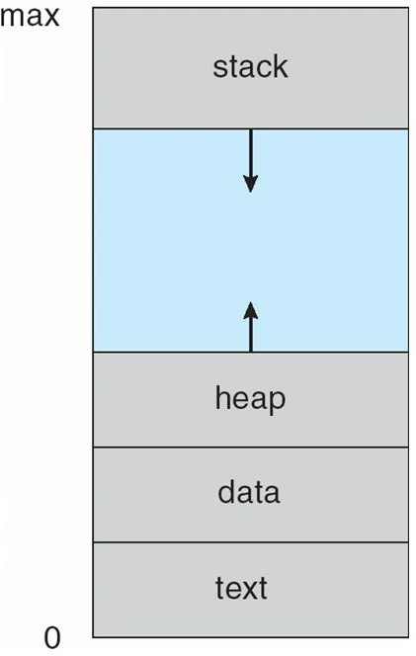
Process in Memory
9/3/2020

Slide 3
The Process
Multiple parts
The program code, also called text section
Current activity including program counter, processor registers
Stack containing temporary data
−Function parameters, return addresses, local variables
Data section containing global variables
Heap containing memory dynamically allocated during run time
Program is passive entity, process is active
Program becomes process when executable file loaded into memory
Execution of program started via GUI mouse clicks, command line entry of its name, etc
One program can be several processes
Consider multiple users executing the same program
9/3/2020

Slide 4
Process State
As a process executes, it changes state
o new: The process is being created
o running: Instructions are being executed
o waiting: The process is waiting for some event to occur
o ready: The process is waiting to be assigned to a processor
o terminated: The process has finished execution
9/3/2020

Slide 5
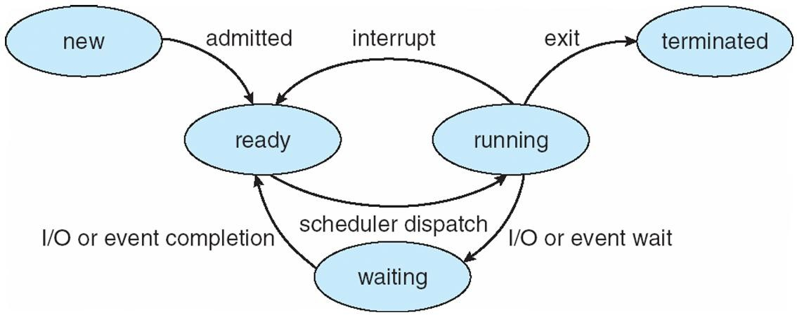
Diagram of Process State
9/3/2020

Slide 6
Process Control Block (PCB)
Contains the process elements
Makes it possible to interrupt a running process and later resume execution as if the interruption had not occurred
Created and managed by the operating system
Key tool that allows support for multiple processes (multiprogramming)
Information associated with each process
Process state
Program counter
CPU registers
CPU scheduling information
Memory-management information
Accounting information
I/O status information
9/3/2020

Slide 7
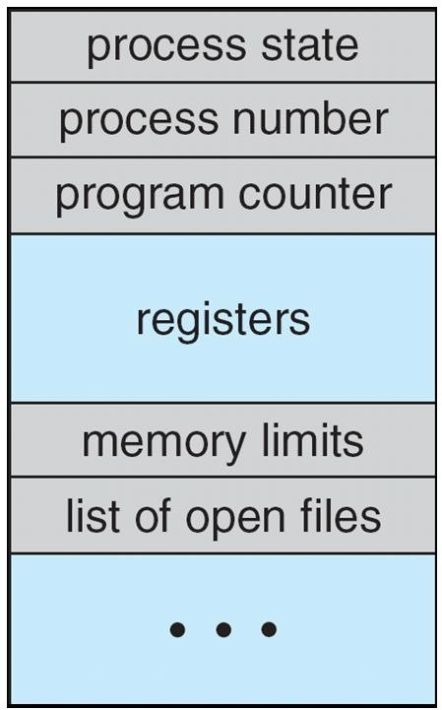
Process Control Block (PCB)
9/3/2020

Slide 8
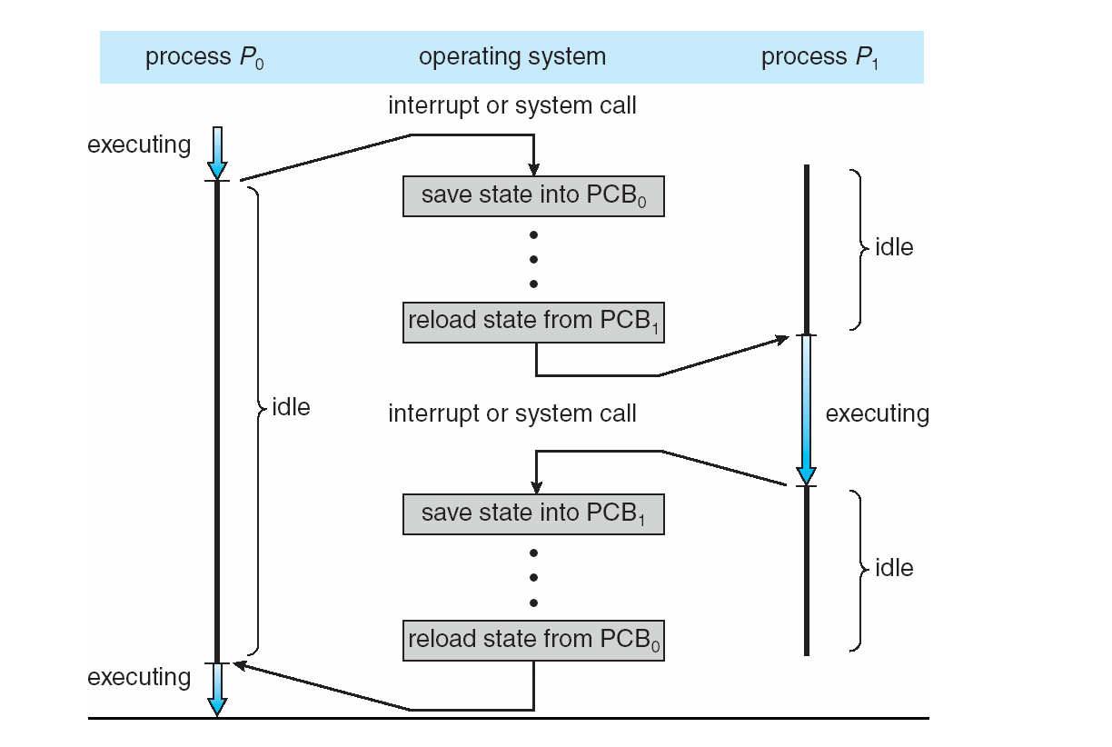
CPU Switch From Process to Process
9/3/2020

Slide 9
Process Scheduling
Maximize CPU use, quickly switch processes onto CPU for time sharing
Process scheduler selects among available processes for next execution on CPU
Maintains scheduling queues of processes
Job queue – set of all processes in the system
Ready queue – set of all processes residing in main memory, ready and waiting to execute
Device queues – set of processes waiting for an I/O device
Processes migrate among the various queues
9/3/2020

Slide 10
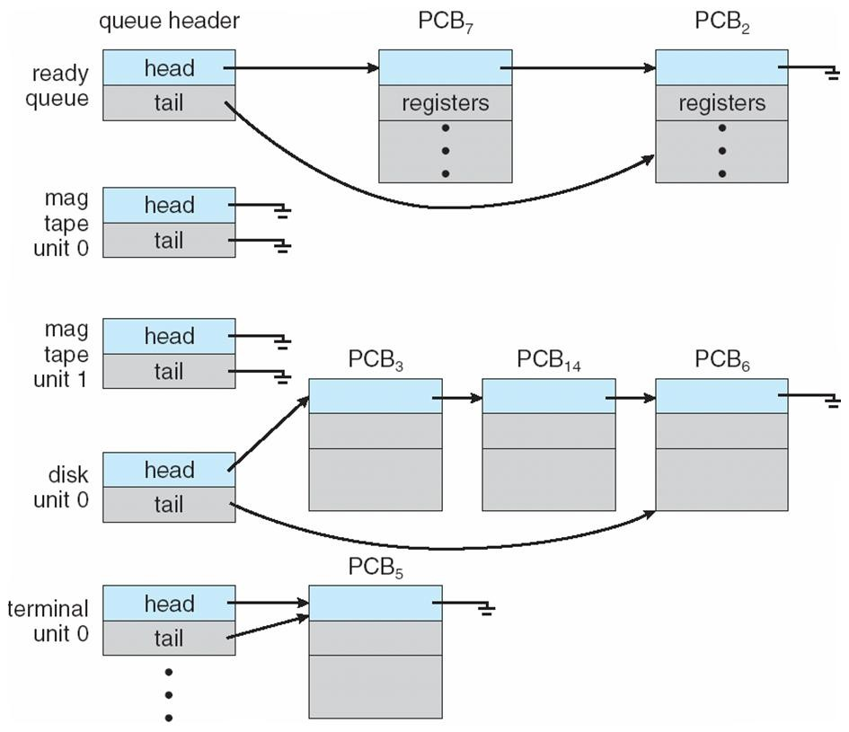
Ready Queue And Various I/O Device Queues
9/3/2020

Slide 11
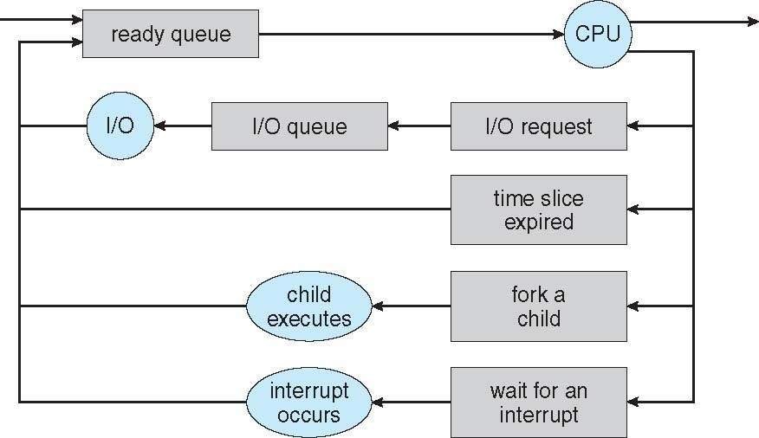
Representation of Process Scheduling
9/3/2020

Slide 12
Schedulers
Long-term scheduler (or job scheduler) – selects which processes should be brought into the ready queue
Short-term scheduler (or CPU scheduler) – selects which process should be executed next and allocates CPU
o Sometimes the only scheduler in a system
9/3/2020

Slide 13
Schedulers (Cont.)
Short-term scheduler is invoked very frequently (milliseconds) ⇒
(must be fast)
Long-term scheduler is invoked very infrequently (seconds, minutes) ⇒ (may be slow)
The long-term scheduler controls the degree of multiprogramming
Processes can be described as either:
I/O-bound process – spends more time doing I/O than computations, many short CPU bursts
CPU-bound process – spends more time doing computations; few very long CPU bursts
9/3/2020

Slide 14
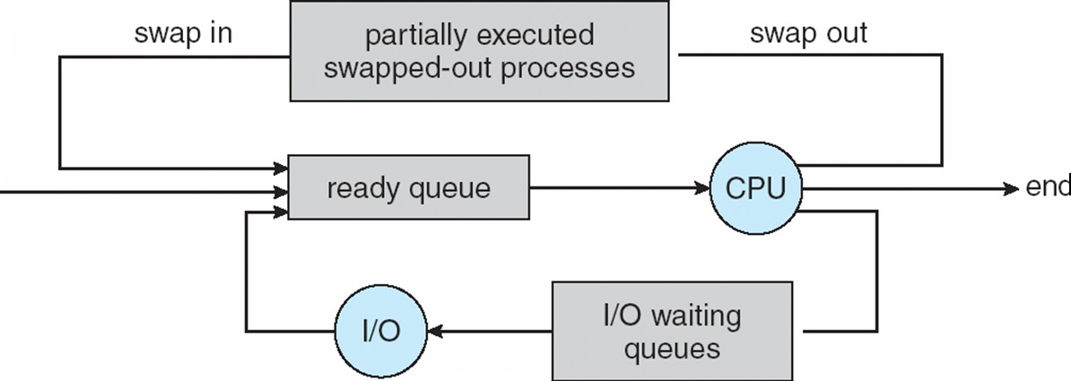
Addition of Medium Term Scheduling
9/3/2020

Slide 15
Context Switch
When CPU switches to another process, the system must save the state of the old process and load the saved state for the new process via a context switch.
Context of a process represented in the PCB
Context-switch time is overhead; the system does no useful work while switching
The more complex the OS and the PCB -> longer the context switch
Time dependent on hardware support
Some hardware provides multiple sets of registers per CPU -> multiple contexts loaded at once
9/3/2020

Slide 16
Process Creation
Parent process create children processes, which, in turn create other processes, forming a tree of processes
Generally, process identified and managed via a process identifier (pid)
Resource sharing
Parent and children share all resources
Children share subset of parent’s resources
Parent and child share no resources
Execution
Parent and children execute concurrently
Parent waits until children terminate
9/3/2020

Slide 17
Process Creation (Cont.)
Address space
Child duplicate of parent
Child has a program loaded into it
UNIX examples
o fork system call creates new process
o exec system call used after a fork to replace the process’ memory space with a new program
9/3/2020

Slide 18
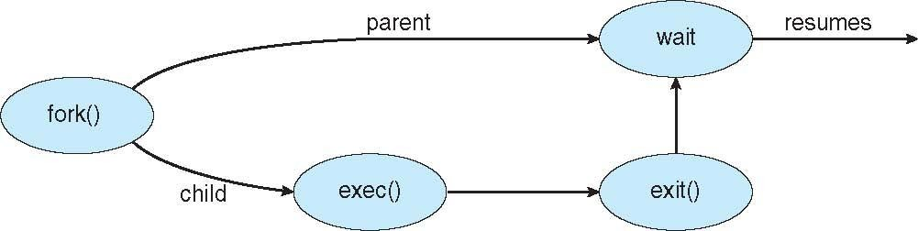
Process Creation
9/3/2020

Slide 19
C Program Forking Separate Process
#include <stdio.h> #include <sys/types.h> #include <unistd.h>
int main()
{
#include <stdio.h> #include <sys/types.h> int main()
{
fork();
fork();
fork(); printf("hello\n");
return 0;
}
#include <stdio.h> #include <ctype.h> #include <limits.h> #include <string.h> #include <stdlib.h> #include <unistd.h>
// make two process which run same
// program after this instruction fork();
int main()
{
int pid; pid=fork();
printf("Hello world!\n"); return 0;
}
if (pid==0) {
printf("I am the child\n"); printf("my pid=%d\n", getpid());
}
return 0;
}
9/3/2020

Slide 20
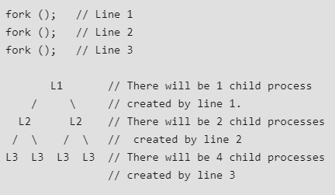
A Tree of Processes
9/3/2020

Slide 21
Process Termination
Process executes last statement and asks the operating system to delete it (exit)
Output data from child to parent (via wait)
Process’ resources are deallocated by operating system
Parent may terminate execution of children processes (abort)
Child has exceeded allocated resources
Task assigned to child is no longer required
If parent is exiting
−Some operating system do not allow child to continue if its parent terminates
All children terminated - cascading termination
9/3/2020

